Slide 1
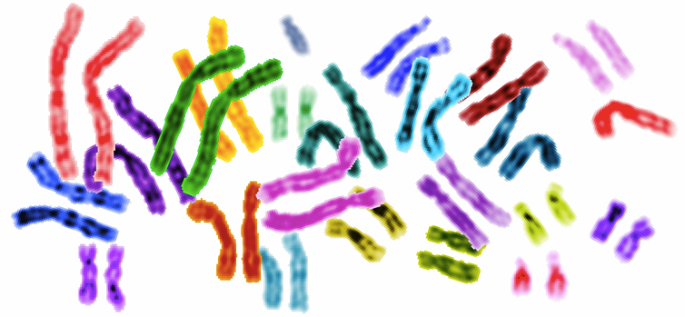
QOTD
Can you go to school with one shoe?

Slide 2
Some things just work well in pairs. Everyday examples include shoes, gloves, and the earbuds on a music player. If you're missing one member of a pair, it's likely to be a nuisance, and might even be a serious problem (for instance, if you're already late for school!).
Pairs are important in genetics, too. Most of your cells contain 46 chromosomes, rod-like structures made of DNA and protein, that come in 23 matched pairs. These chromosomes carry tens of thousands of genes, which tell your body how to develop and which keep it functioning from moment to moment during your lifetime.
Notes:
If a chromosome pair loses or gains a member, or even part of a member, the delicate balance of the human body may be disrupted. Today, we’ll examine how changes in chromosome number and structure come about, and how they can affect human health.

Slide 3
Agenda
Objectives
List different types of mutations
Relate non disjunction with disorders
Identify abnormalities in a karyotype
Differentiate between structure of chromosome before and after the mutation
Vocabulary
Abnormalities
Autosomal dominant/ recessive/co-dominant
Aneuploidy
Polyploidy
Inversion
Mutagens

Slide 4
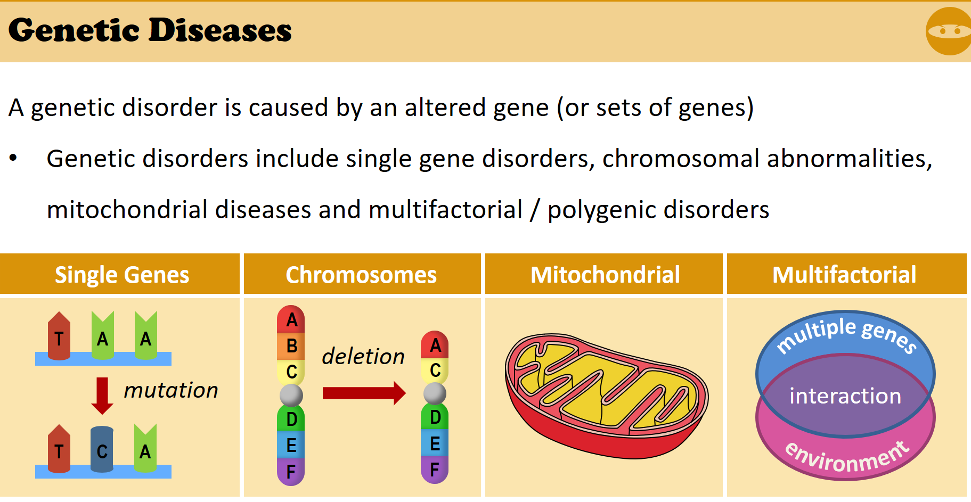

Slide 5
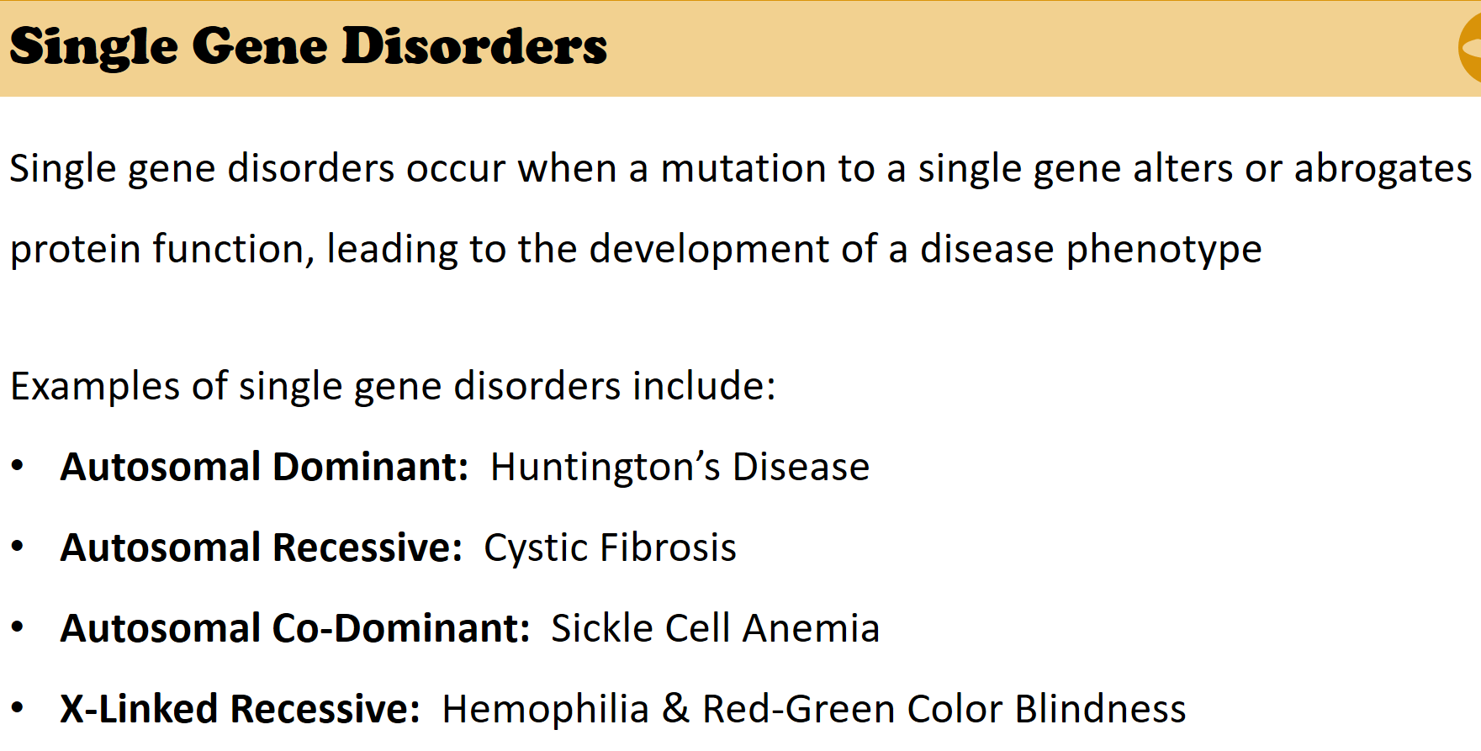
1- Single Gene disorder

Slide 6
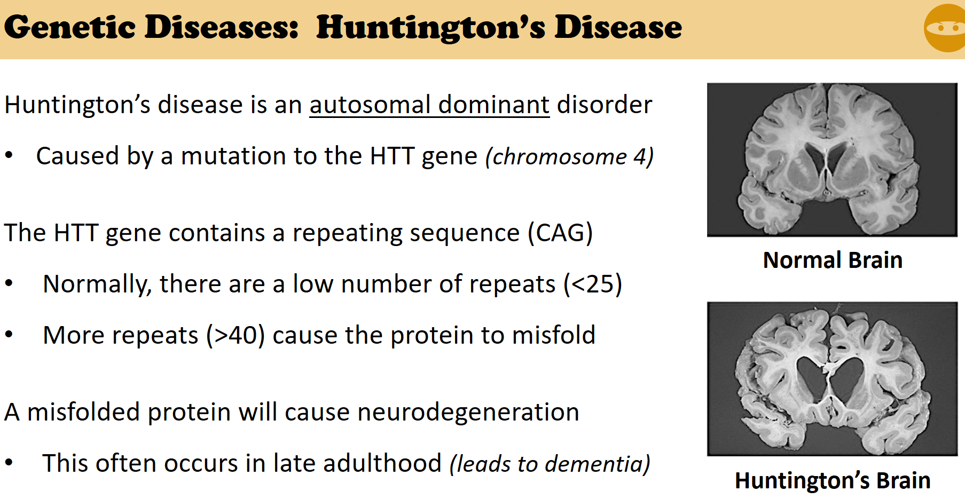

Slide 7
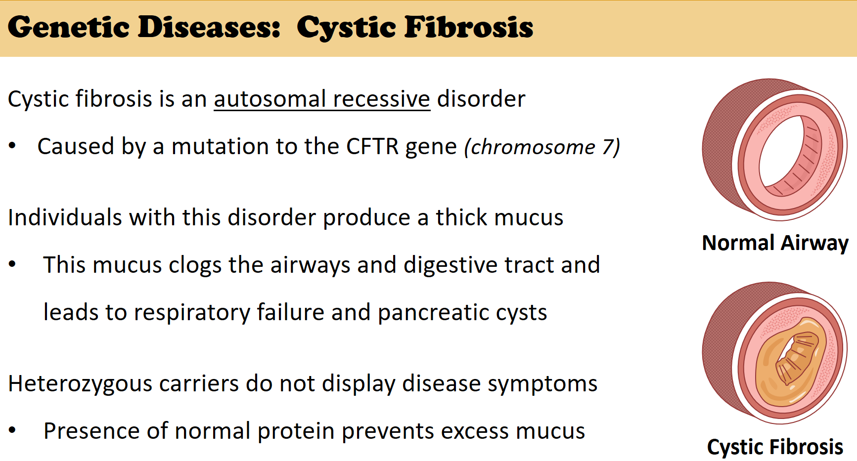

Slide 8
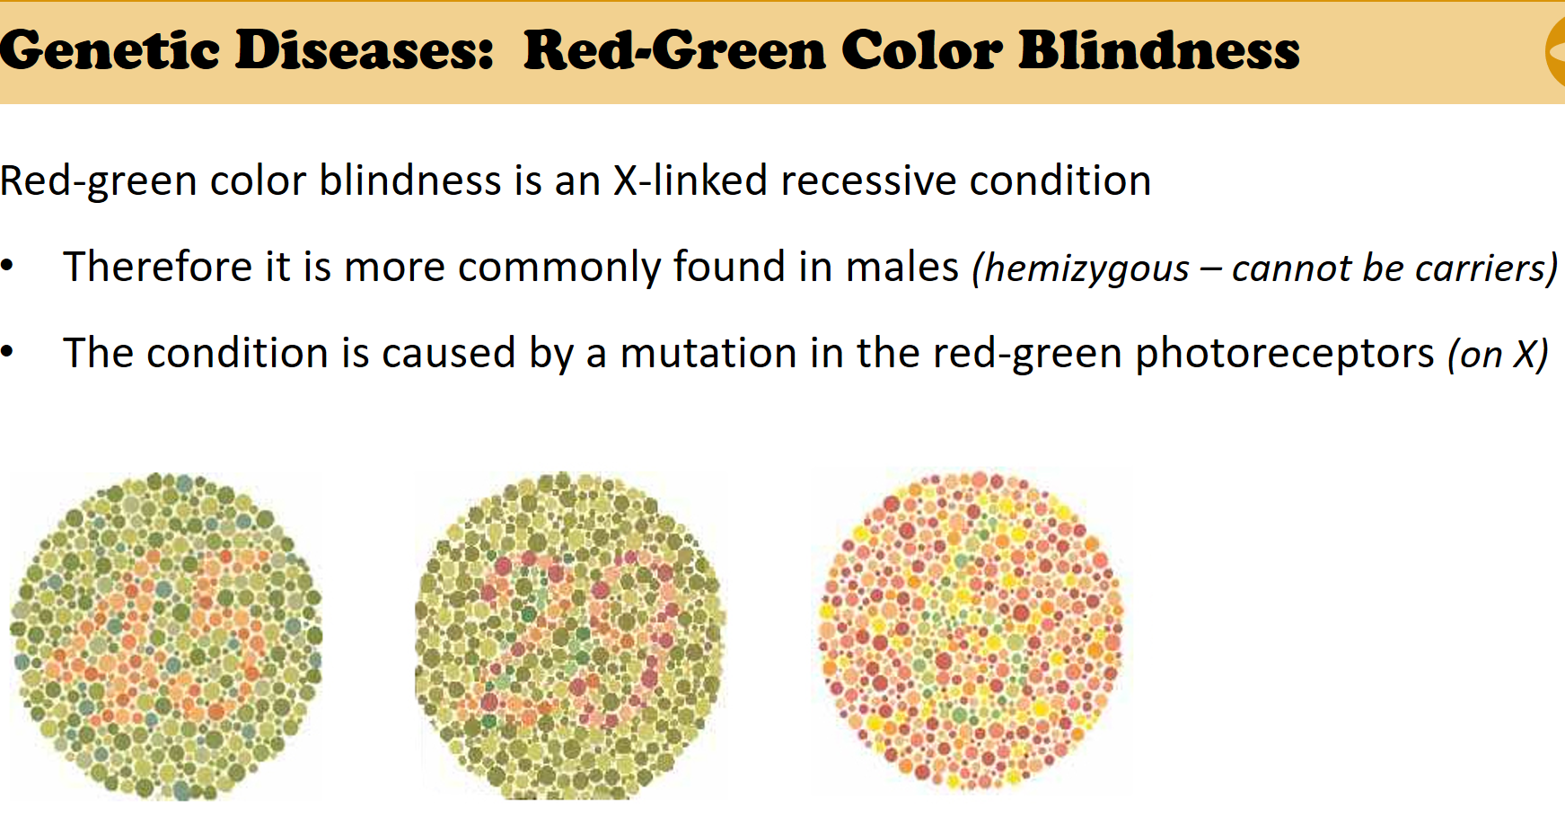

Slide 9
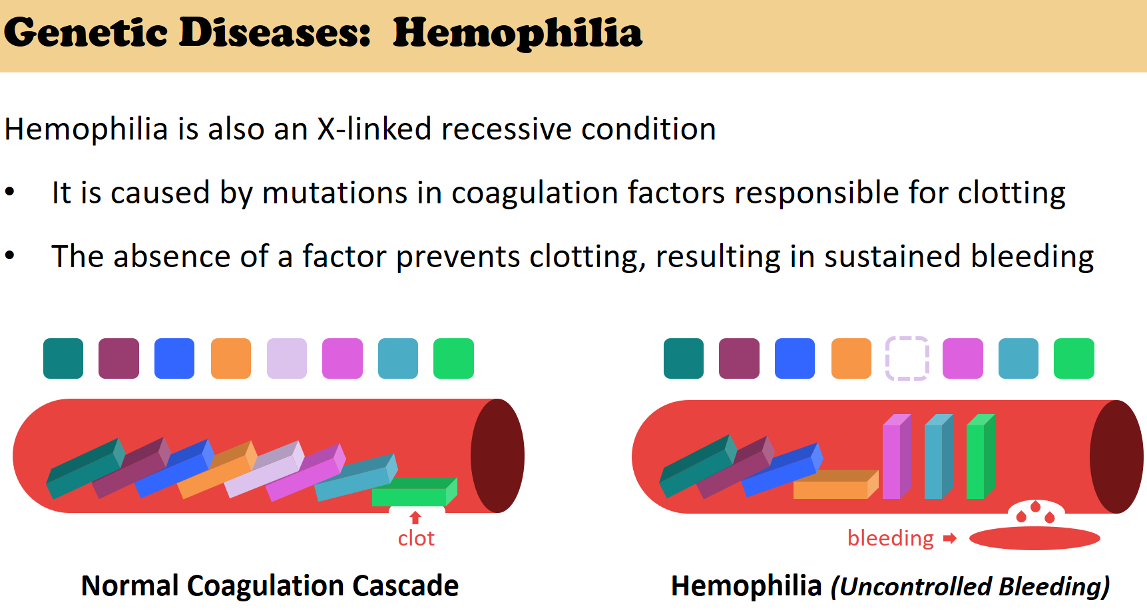

Slide 10
2- Chromosomal Abnormalities
In nondisjunction, pairs of homologous chromosomes do not separate normally during meiosis
As a result, one gamete receives two of the same type of chromosome, and another gamete receives no copy

Slide 11

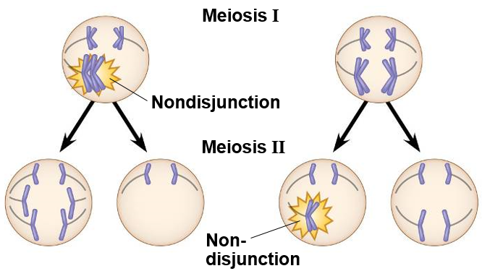
When does it Happen?

Slide 12
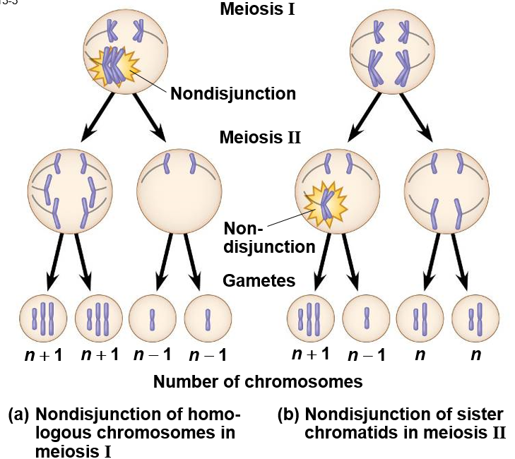

Slide 13
Aneuploidy (Extra or missing chromosomes)
Aneuploidy results from the fertilization of gametes in which nondisjunction occurred
Offspring with this condition have an abnormal number of a particular chromosome
A monosomic zygote has only one copy of a particular chromosome
A trisomic zygote has three copies of a particular chromosome
Notes:
Intro: Alterations of chromosome number and structure are associated with some serious disorders
Some types of aneuploidy appear to upset the genetic balance less than others, resulting in individuals surviving to birth and beyond
These surviving individuals have a set of symptoms, or syndrome, characteristic of the type of aneuploidy

Slide 14
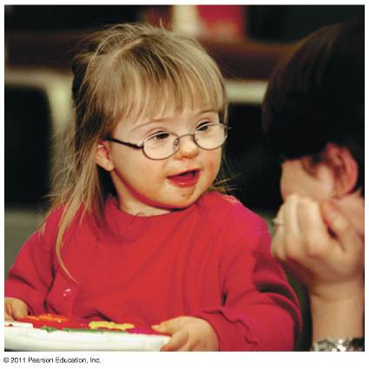
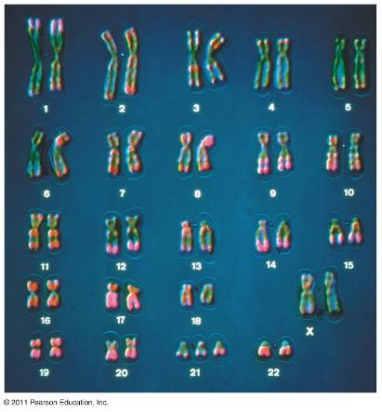
Down Syndrome (Trisomy 21)
Down syndrome is an aneuploid condition that results from three copies of chromosome 21
It affects about one out of every 700 children born in the United States
The frequency of Down syndrome increases with the age of the mother, a correlation that has not been explained

Slide 15
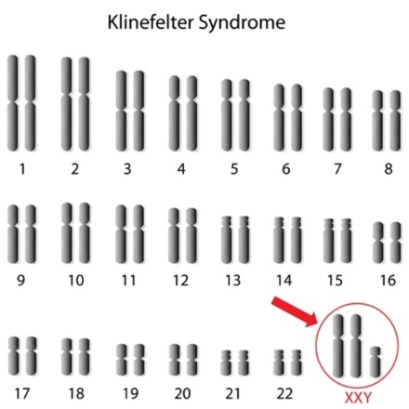
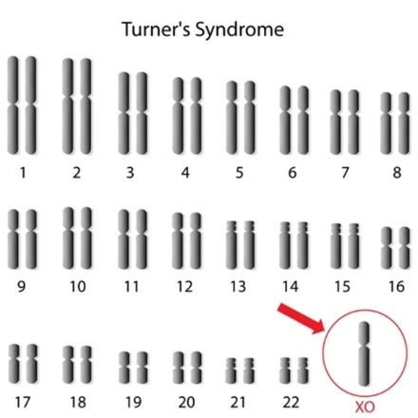
Aneuploidy of Sex Chromosomes
Nondisjunction of sex chromosomes produces a variety of aneuploid conditions
Klinefelter syndrome is the result of an extra chromosome in a male, producing XXY individuals
Monosomy X, called Turner syndrome, produces X0 females, who are sterile; it is the only known viable monosomy in humans

Slide 16
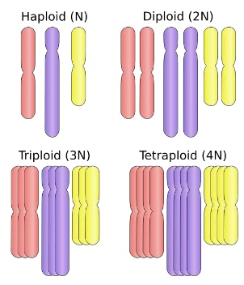
Polyploidy
Polyploidy is a condition in which an organism has more than two complete sets of chromosomes
  Triploidy (3n) is three sets of chromosomes
  Tetraploidy (4n) is four sets of chromosomes
Polyploidy is common in plants, but not animals
Polyploids are more normal in appearance than aneuploids

Slide 17
Alterations of Chromosome Structure
Breakage of a chromosome can lead to four types of changes in chromosome structure
  Deletion removes a chromosomal segment
  Duplication repeats a segment
  Inversion reverses orientation of a segment within a chromosome
  Translocation moves a segment from one chromosome to another

Slide 18
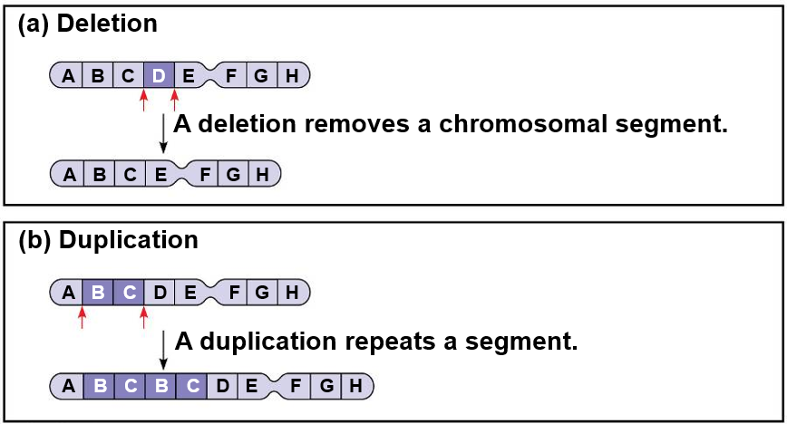

Slide 19
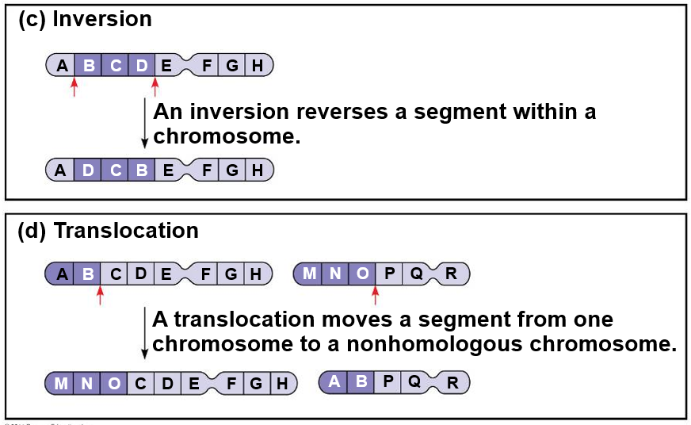

Slide 20
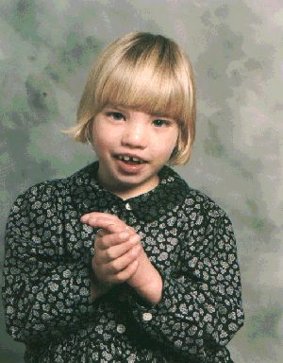
Disorders Caused by Structurally Altered Chromosomes
The syndrome cri du chat (“cry of the cat”), results from a specific deletion in chromosome 5
A child born with this syndrome is mentally retarded and has a catlike cry; individuals usually die in infancy or early childhood
Certain cancers, including chronic myelogenous leukemia (CML), are caused by translocations of chromosomes

Slide 21
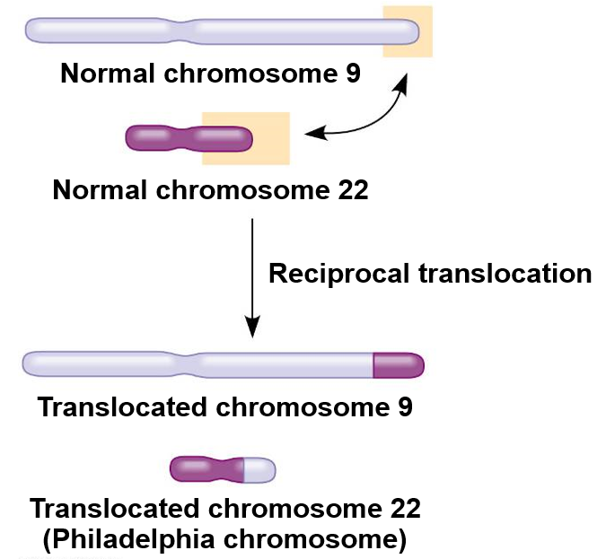

Slide 22

3-mitochondrial diseases
Extranuclear genes (or cytoplasmic genes) are found in organelles in the cytoplasm
Mitochondria, chloroplasts, and other plant plastids carry small circular DNA molecules
Extranuclear genes are inherited maternally because the zygote’s cytoplasm comes from the egg
The first evidence of extranuclear genes came from studies on the inheritance of yellow or white patches on leaves of an otherwise green plant

Slide 23
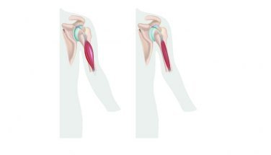
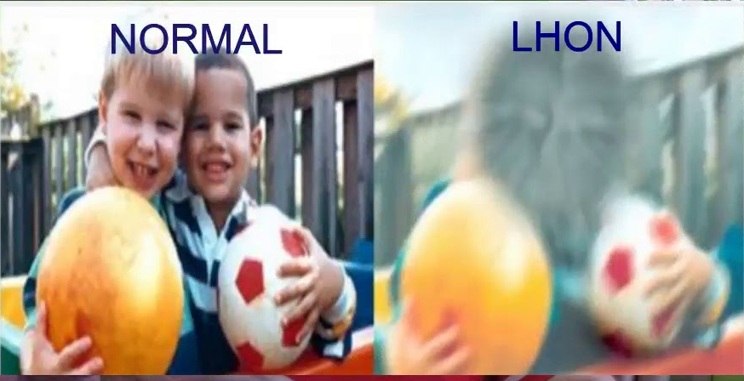
Some defects in mitochondrial genes prevent cells from making enough ATP and result in diseases that affect the muscular and nervous systems
  For example,
  mitochondrial myopathy
  Leber’s hereditary optic neuropathy

Slide 24
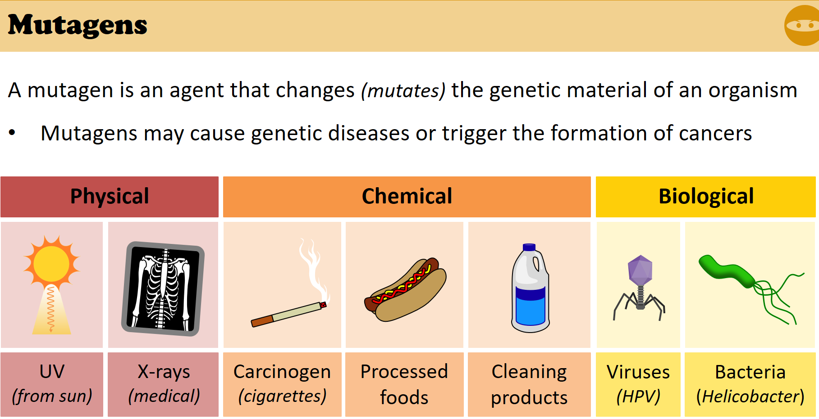
Notes:
https://www.khanacademy.org/science/ap-biology/heredity/chromosomal-inheritance-ap/a/aneuploidy-and-chromosomal-rearrangements

